Slide 1
Production Planning & Control
Reference Book: Operations Management by Stevension

Slide 2
CPM & PERT

Slide 3
The objective of CPM & PERT
1. A graphical display of project activities. 2. An estimate of how long the project will take. 3. An indication of which activities are the most critical to timely project completion. 4. An indication of how long any activity can be delayed without delaying the project

Slide 4
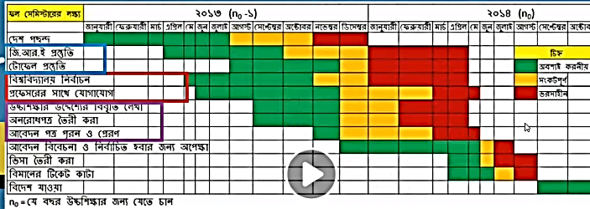
Gantt Chart

Slide 5
Time estimates include:
1) Total time for completion. 2) ES- Earliest start time: the earliest time at which the activity can start given that its precedent activities must be completed first. 3) EF-Earliest finish time: equals to the earliest start time for the activity plus the time required to complete the activity. 4) LF- Latest finish time: the latest time in which the activity can be completed without delaying the project. 5) LS- Latest start time: equal to the latest finish time minus the time required to complete the activity.

Slide 6
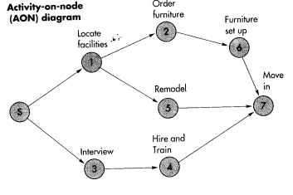
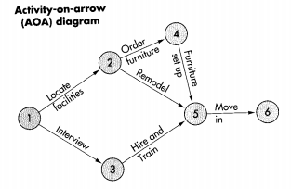
Network Diagram

Slide 7
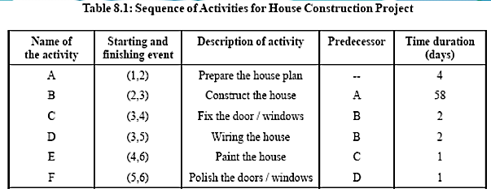
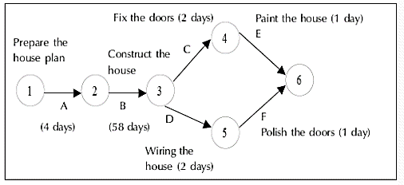

Slide 8
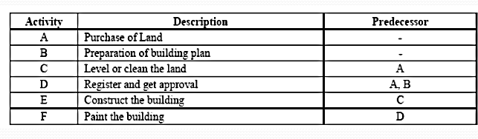
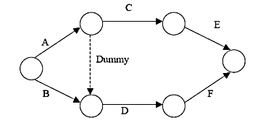
Network diagram with dummy activities

Slide 9
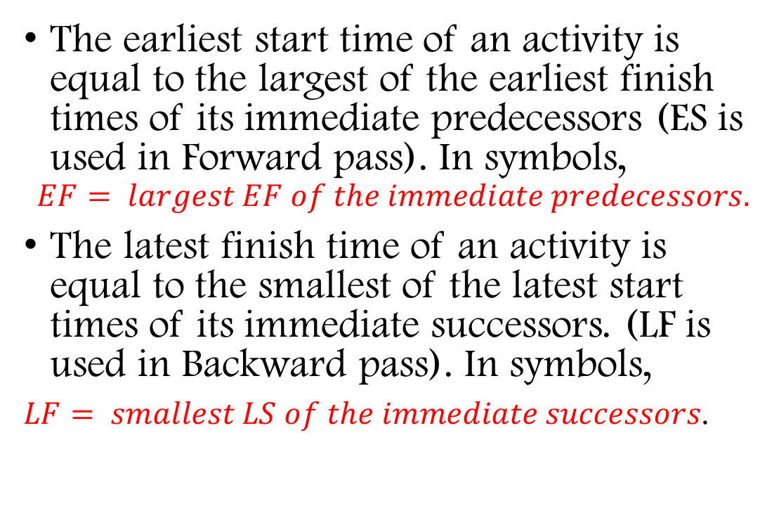
CPM
Critical path: the longest path; determine the expected project duration
The (estimated) project duration equals the length of the longest path through the project network. This longest path is called the critical path. (If more than one path tie for the longest, they all are critical paths.)
The earliest start time of an activity is equal to the largest of the earliest finish times of its immediate predecessors (ES is used in Forward pass). In symbols,
$$EF= largest EF of the immediate predecessors.$$
The latest finish time of an activity is equal to the smallest of the latest start times of its immediate successors. (LF is used in Backward pass). In symbols,
$LF= smallest LS of the immediate successors$.

Slide 10
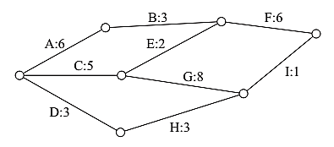
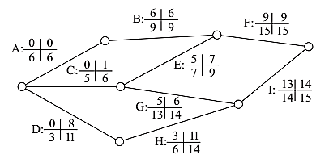
The project network below shows activity durations in weeks. There is a likelihood that Activity D cannot start until the end of Week 3. In this context, the earliest that the project can be completed is the end of Week: A. 15 B. 17 C. 18 D. 43
The diagram with early start, late start, early finish, and late finish times is as follows: Activity: ES: earliest start EF: earliest finish LS: latest start LF: latest finish
ES LS EF LF
The critical path is A–B–F. Activity D has slack of 8 weeks, so starting Activity D at the end of Week 3 will not affect the completion date. Therefore, A–B–F will still be the critical path with a time of 15 weeks.

Slide 11
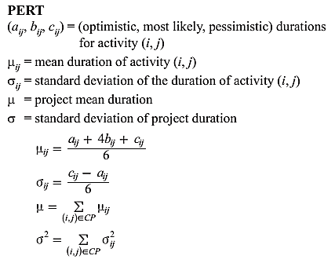
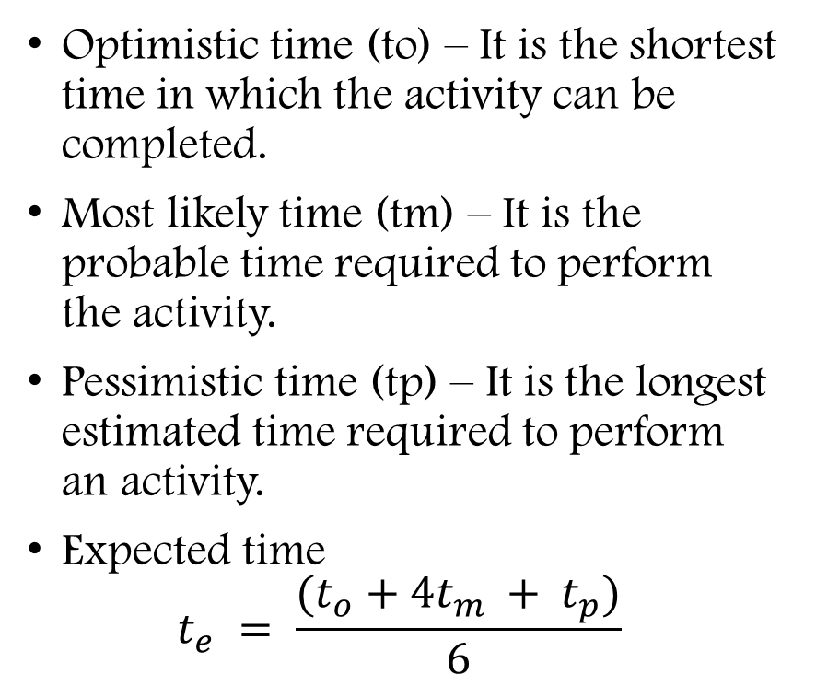
PERT
Optimistic time (to) – It is the shortest time in which the activity can be completed.
Most likely time (tm) – It is the probable time required to perform the activity.
Pessimistic time (tp) – It is the longest estimated time required to perform an activity.
Expected time $t_{e} = \frac{{(t}_{o} + 4t_{m} + t_{p})}{6}$

Slide 12
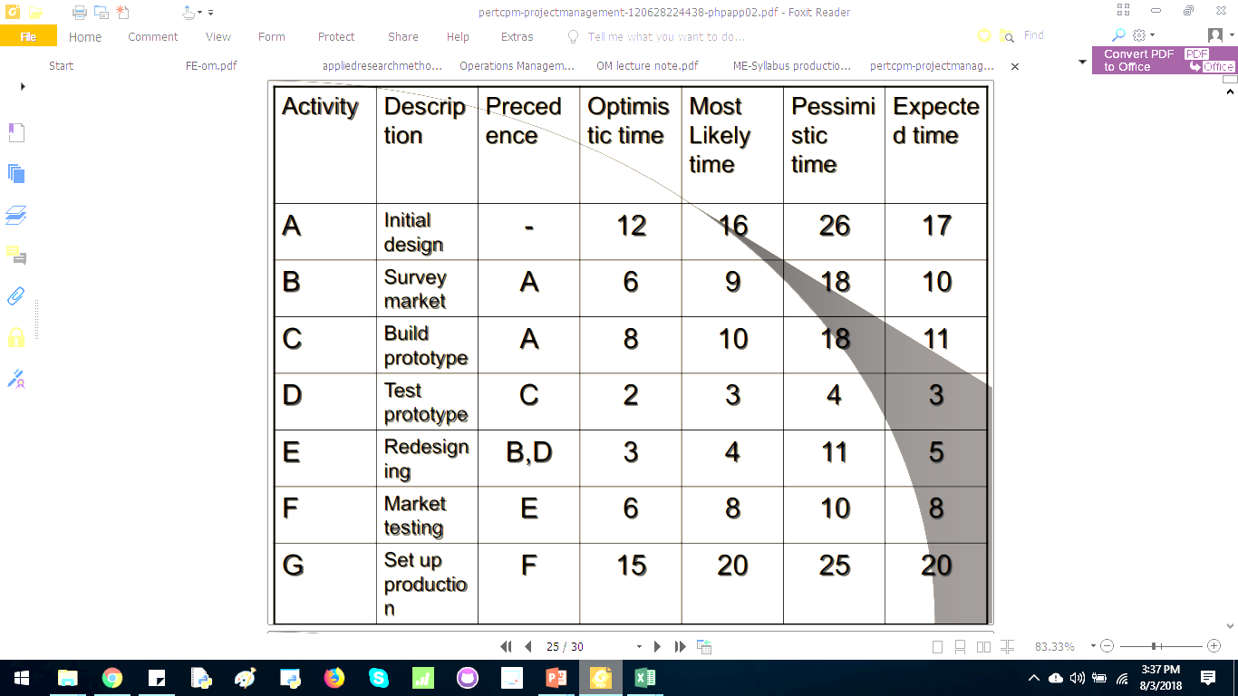
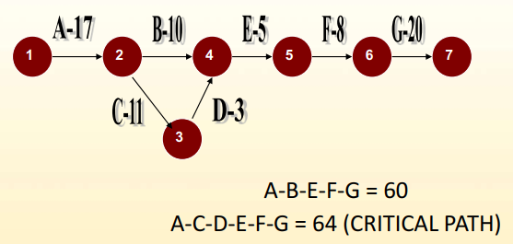
Math problem in PERT
Construct the network diagram
Determine the CP as well
Find the project duration

Slide 13
Line Balancing

Slide 14
Line Balancing
Line Balancing: the process of assigning tasks to workstations in such a way that the workstations have approximately equal time requirements
Cycle time: The maximum time allowed at each workstation to perform assigned tasks before the work moves on. The cycle time also establishes the output rate of a line.

Slide 15
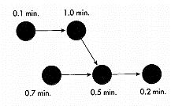

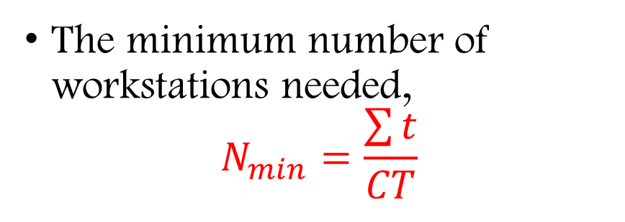
Line Balancing
The minimum number of workstations needed,
$$N_{min}=\frac{\sum{t}}{CT}$$
$Output=\frac{OT}{CT}$
OT = Operating time
CT = Cycle time
Math problem: Given, CT = 1
Solution:
N_min = (.1+1+.7+.5+.2)/1 = 2.5 stations = 3 stations
Notes:
P 245 stev

Slide 16
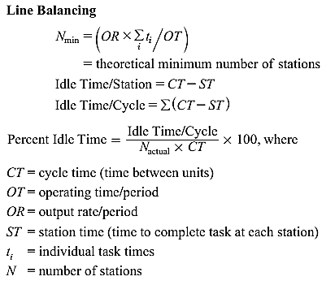

Slide 17
